Slide 1
PIGSARData- R package of Data for PIGSAR project
Chengshu
Mora Lab
Group Meeting, 15/01/2019
Notes:
1

Slide 2
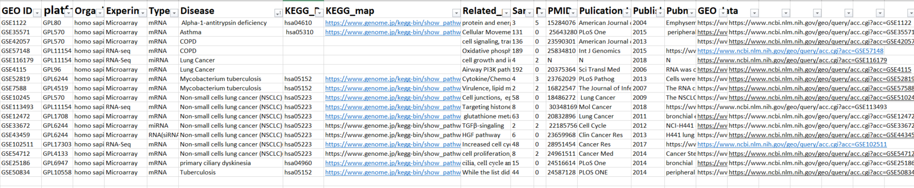
Datasets sources
Disease information from KEGG:
COPD, lung cancer(LUAD), Non-small cells lung cancer (NSCLC), Asthma,
Mycobacterium tuberculosis
1
Notes:
2

Slide 3
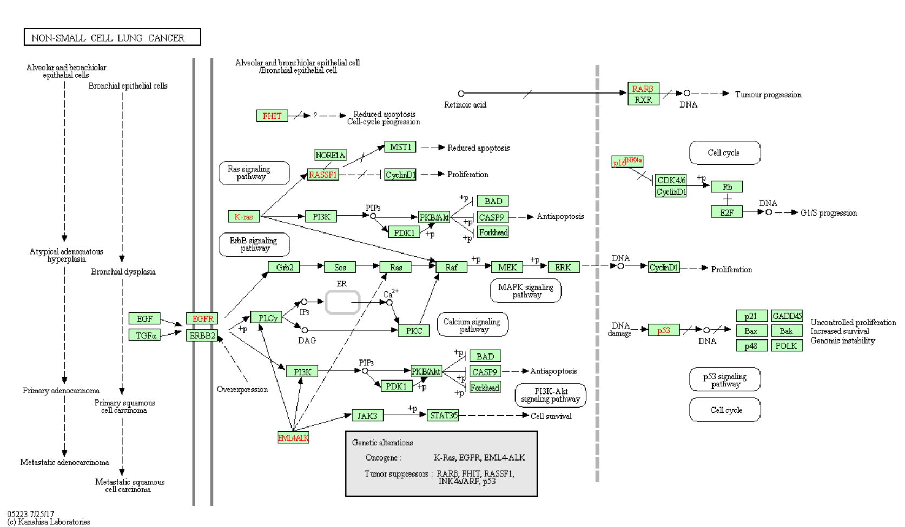
Datasets sources
18 GSE series datasets
913 samples in total
hsa05223, hsa04610,
hsa05152
1
Notes:
3

Slide 4
Format:
ExpressionSet class in R pacjage “Biobase”
The functions used in “ExpressionSet” class can be used to extract the information.
Like :
exprs() : get the expression data of the object
pData() : get the phenotypic data of the object
fData() : get the feature data of the object
experimentData() : experiment information
sampleNames(): get sample names
featureNames(): get features(genes) names
annotation(): get the platform ID or other information
3

Slide 5
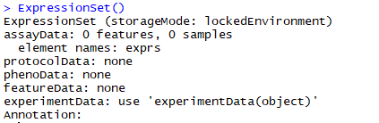
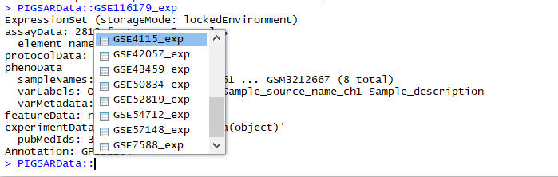
“ExpressionSet“ class:
Container for high-throughput assays and experimental metadata.
In my data package: “GSEXXX_exp” is the object with ExpressionSet class, which includes assayData, phenotypic Data, features data and experiment data(the matrix series information from GEO database).
Not include protocol data
4

Slide 6
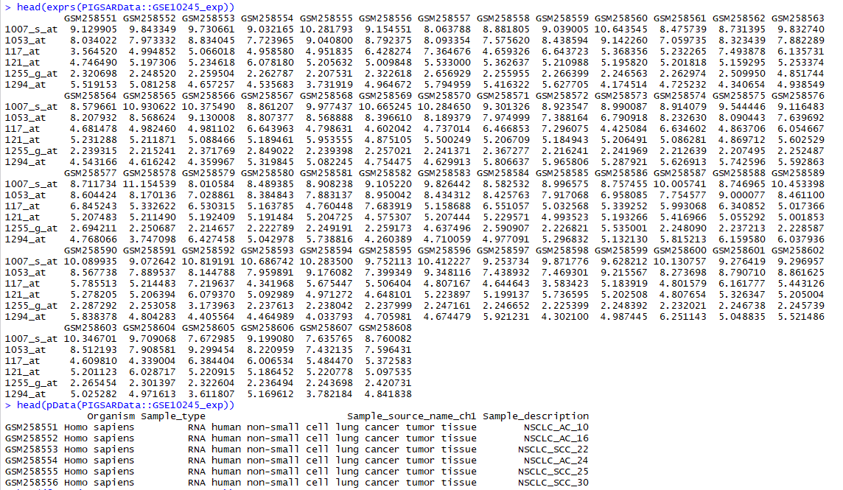
5

Slide 7
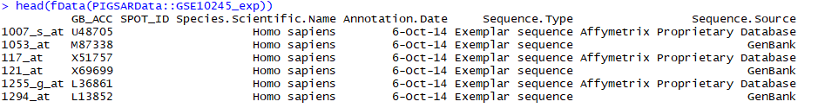
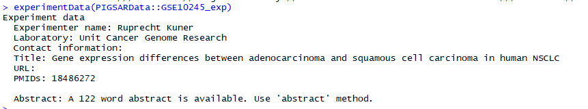
You can use abstract () to get the abstract or summary of this experiment.
pubMedIDs() is used to get the published papers.
6

Slide 8
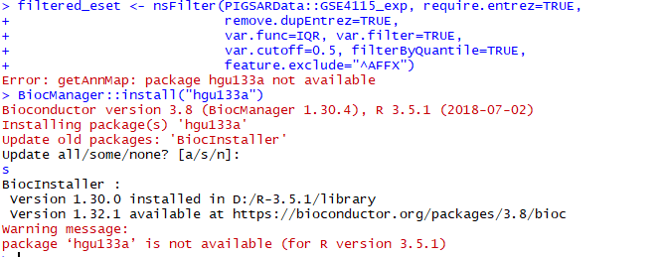
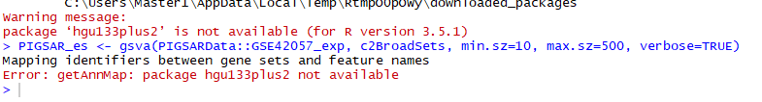
Applied to methods:
GSVA……
Expression data
Gene sets information
6

Slide 9


Thank you!

